Slide 1
Intro to WPF (or Windows Presentation Foundation )
Aviad Sachs; The Open University (20526); Jan 27th 2015;
Look 4 source code @ GitHub

Slide 2
This intro will cover
What is Windows Presentation Foundation ?
What is XAML ?
WPF Core Controls
WPF Data Binding Model
WPF Animation & Styles
Expert’s tips

Slide 3
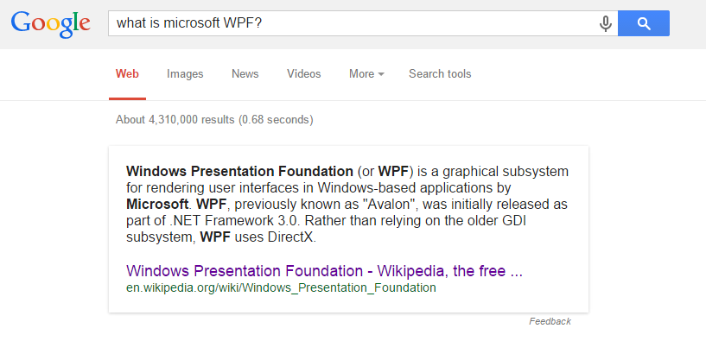

What is WPF?
Framework for easy, flexible & dynamic UI
Based on a mark-up language - XAML
Not only for Desktops
(Windows Store, Windows Phone 7/8)

Slide 4
Now really, what it is?
XAML based files for UI rendering.
Backed up by your .Net code files (C#,VB..)
WPF makes all of these work together like magic..
+ much more cool stuff you can do real quick

Slide 5
1st Demo
New Project
Project Files
The WPF Designer
Notes:
Open VS
New Project (C#)
WPF
Review Files & Window
Show MainWindow.xaml – View/Edit/Split

Slide 6
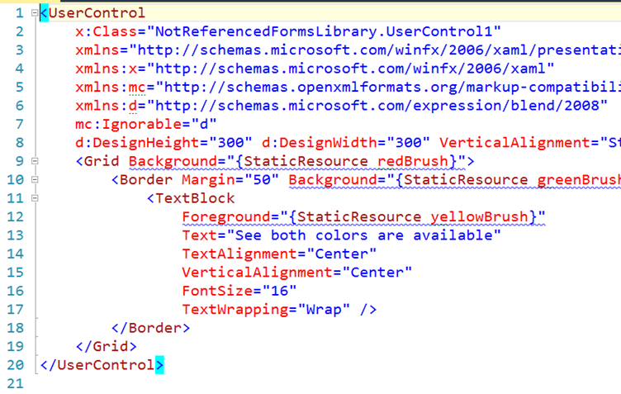
What is XAML ?
XML based
Define UI Controls
Define their properties
Make rules and dependencies

Slide 7
Demo 2 – XAML Intro
Basic XAML coding
Basic Controls
Basic
Notes:
http://www.openu.ac.il/_layouts/OpenU_WWW/Theming/Responsive/images/logo_op2.jpg
private void Hyperlink_RequestNavigate(object sender, RequestNavigateEventArgs e)
{
Process.Start(new ProcessStartInfo(e.Uri.AbsoluteUri));
e.Handled = true;
}

Slide 8
Demo 3
WPF Core Controls
Common
Panels
Custom
Notes:
http://www.openu.ac.il/_layouts/OpenU_WWW/Theming/Responsive/images/logo_op2.jpg
private void Hyperlink_RequestNavigate(object sender, RequestNavigateEventArgs e)
{
Process.Start(new ProcessStartInfo(e.Uri.AbsoluteUri));
e.Handled = true;
}

Slide 9
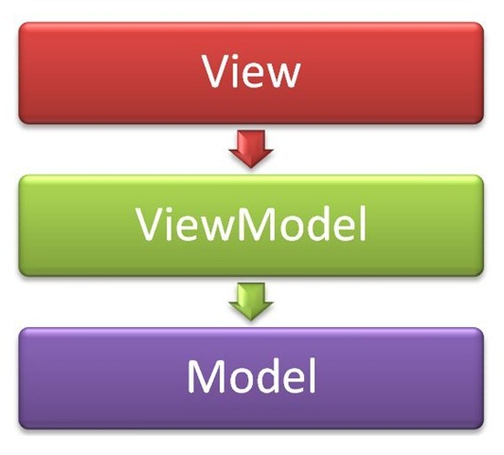
WPF Data Binding Model
MVVM Pattern
User interacts with the Views
The App Logic changes the Model
Keep it sync !
Notes:
No threading, no queue for UI operation, etc

Slide 10
Demo 4
Data Binding using only XAML
Keep UI updated
Notes:
Good tutorial on Basic Binding: http://www.codeproject.com/Articles/29054/WPF-Data-Binding-Part

Slide 11
Demo 5
WPF Animation
Code VS. WPF
Notes:
https://msdn.microsoft.com/en-us/library/ms752312.aspx

Slide 12
Expert Tips
Extended WPF Toolkit @ CodePlex
Microsoft Blend for Visual Studio 2013
Meet once with a XAML Specialist and ask for code !

Slide 13

?
© Aviad Sachs Jan, 2015

